Slide 1

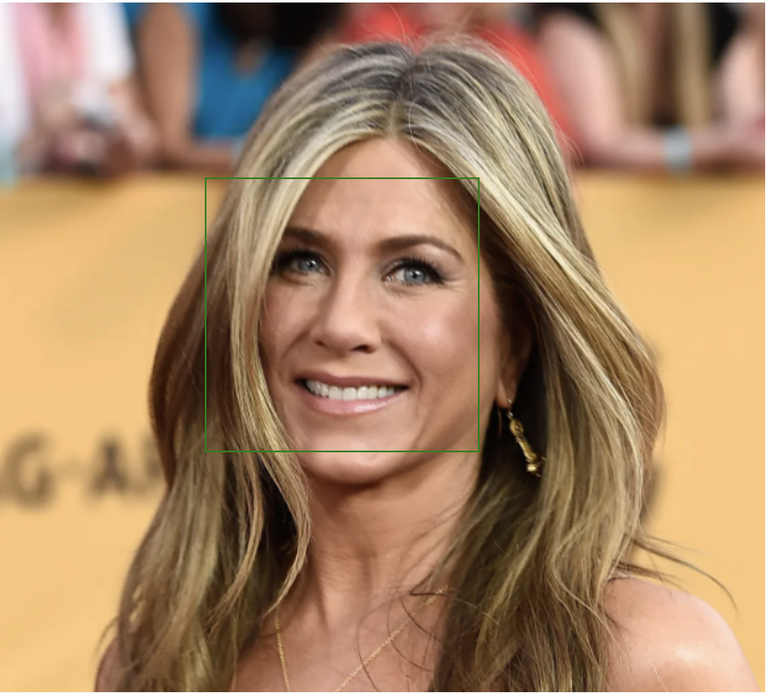
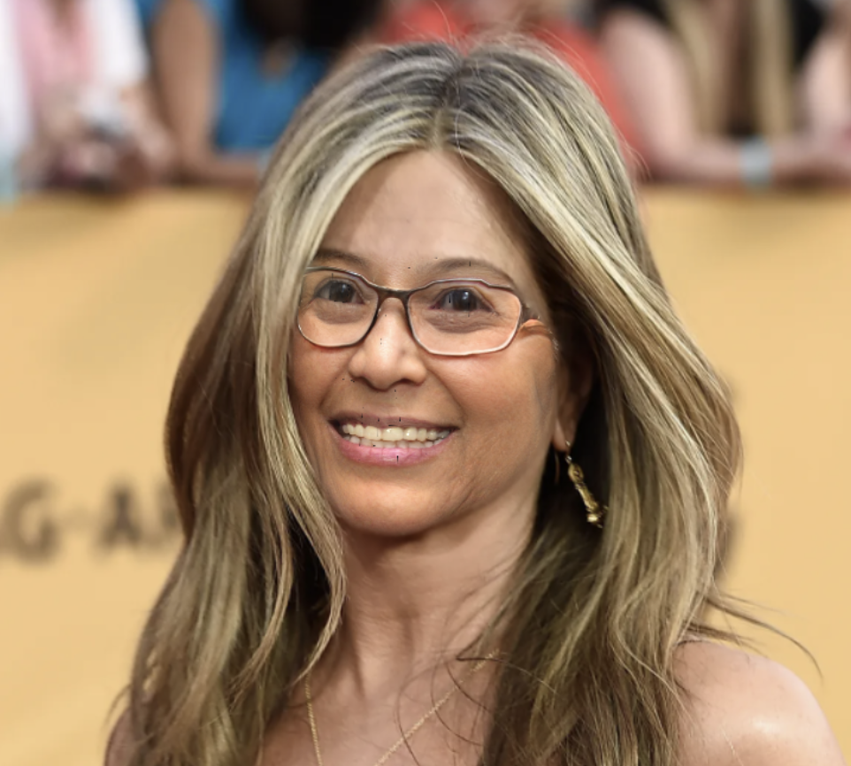
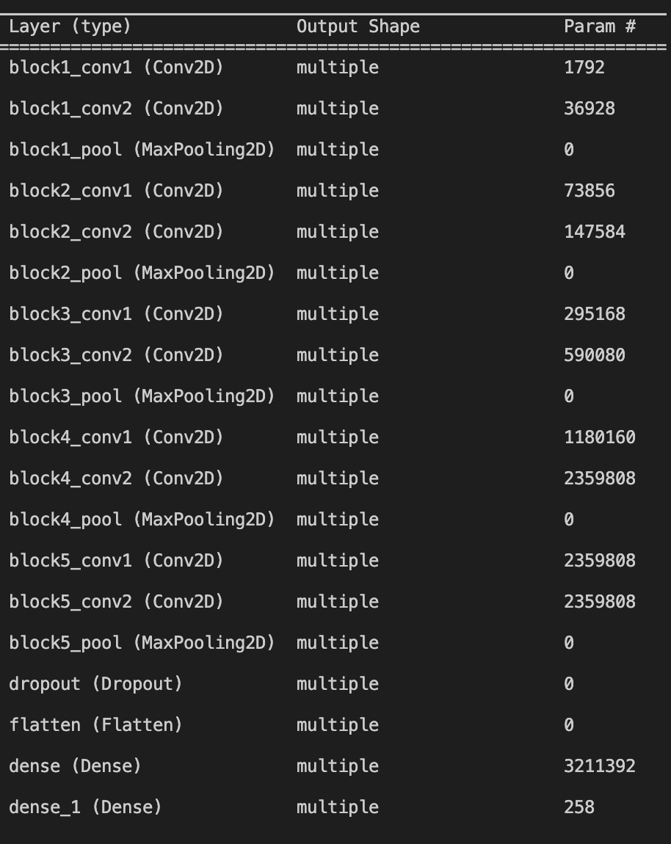
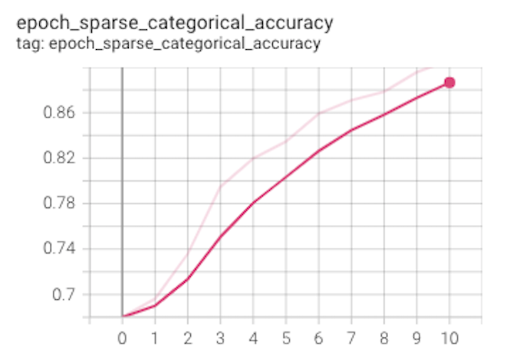
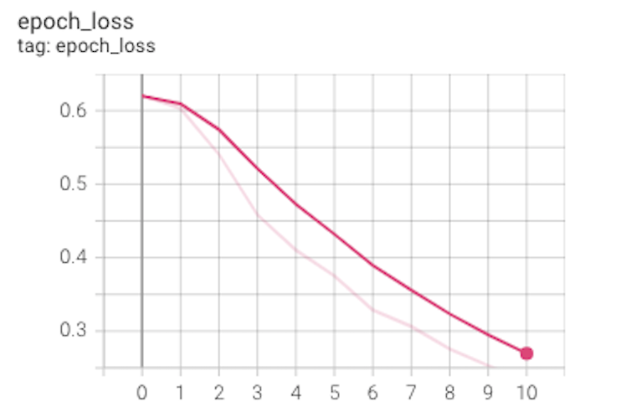
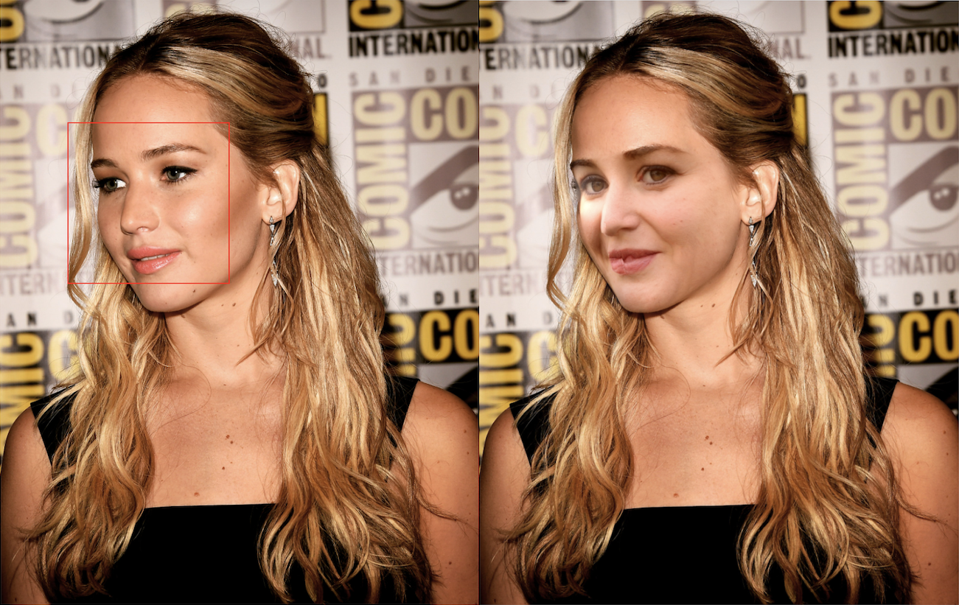
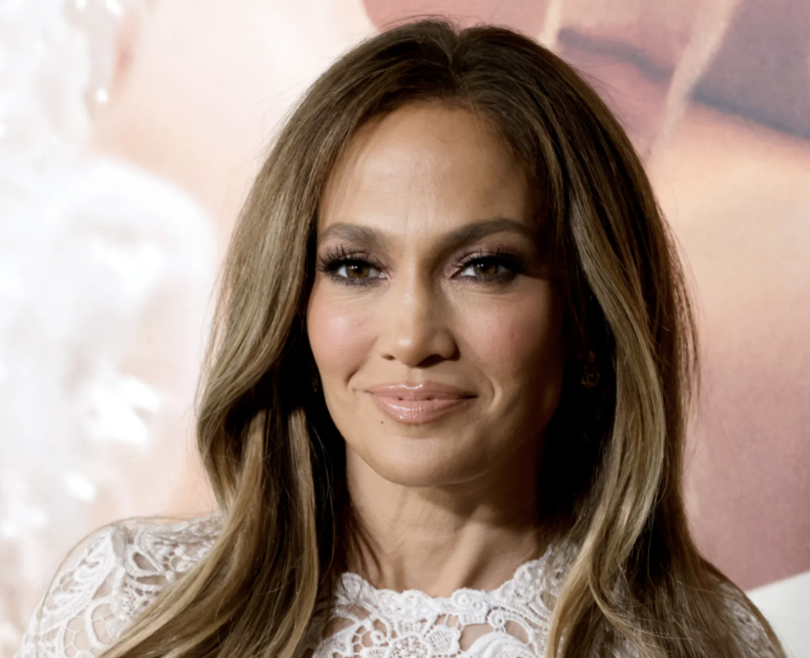

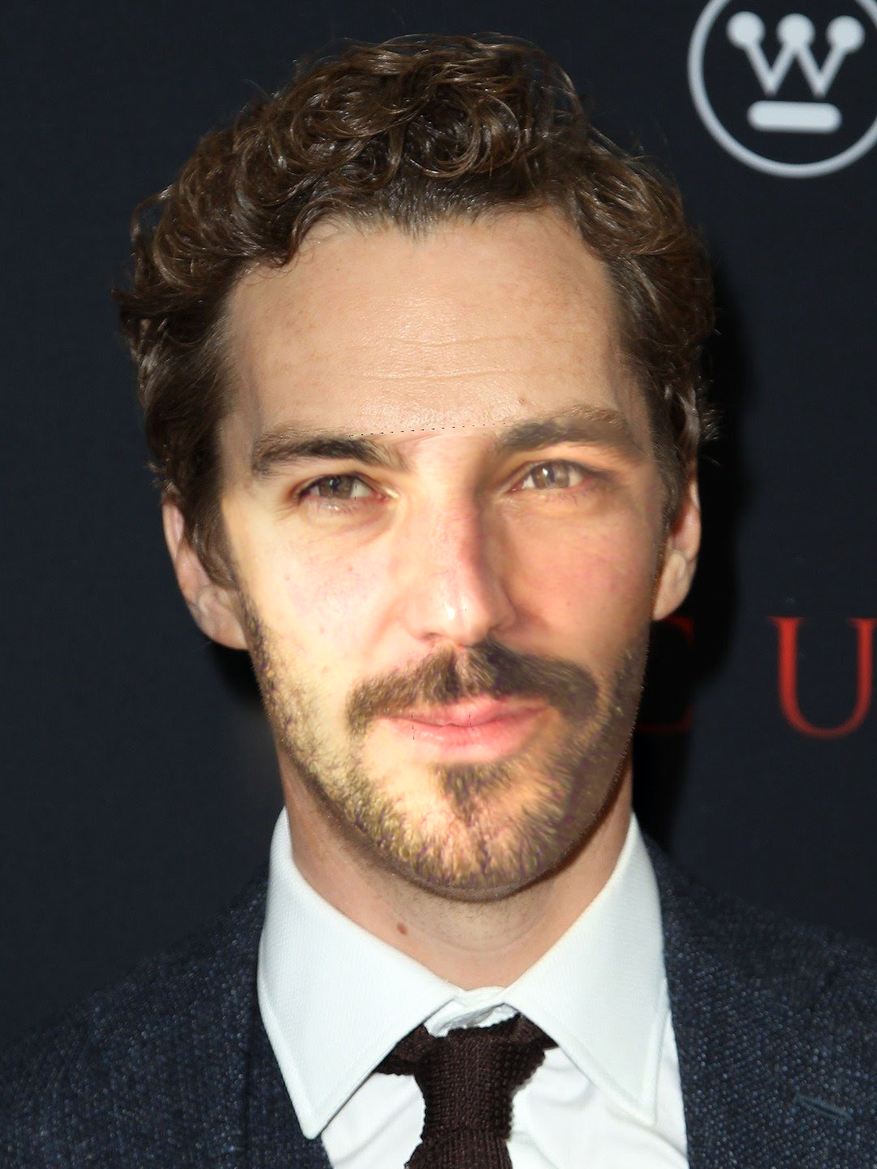
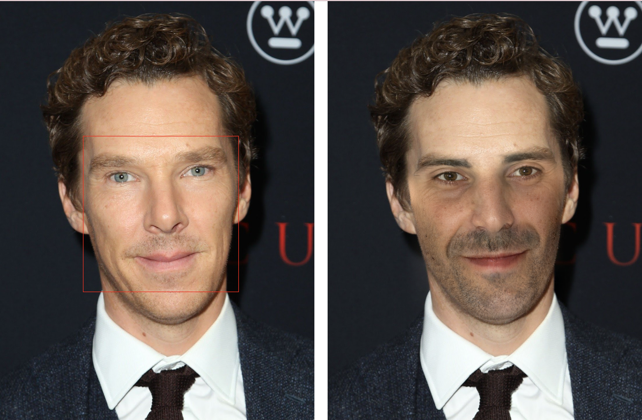
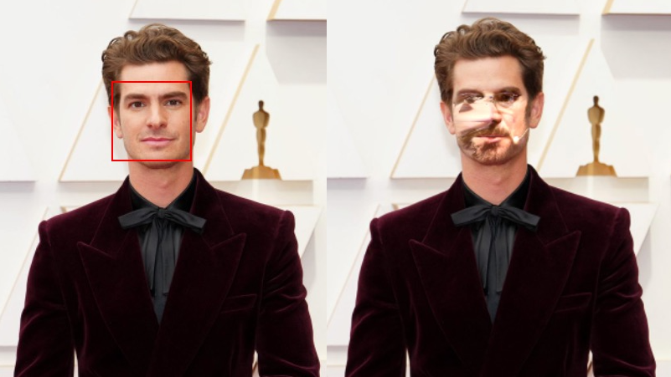
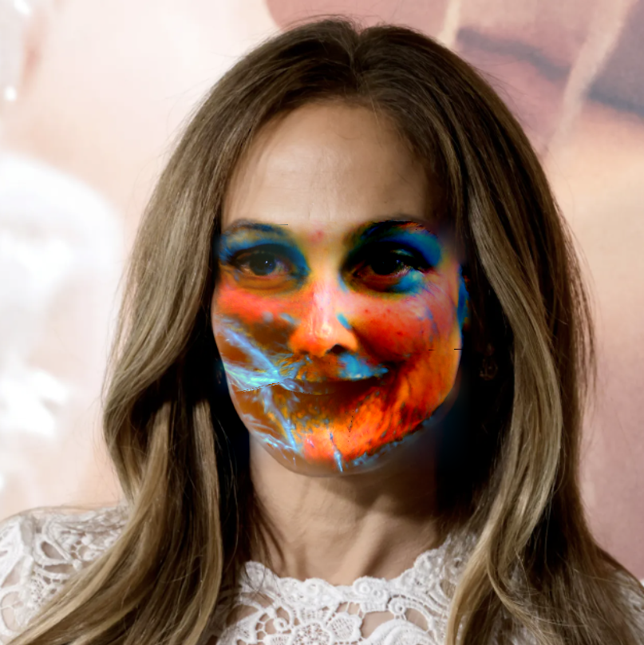
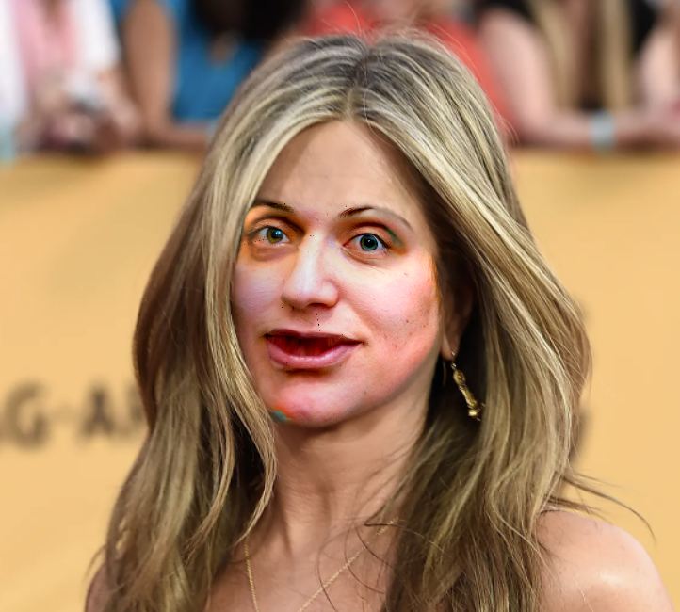
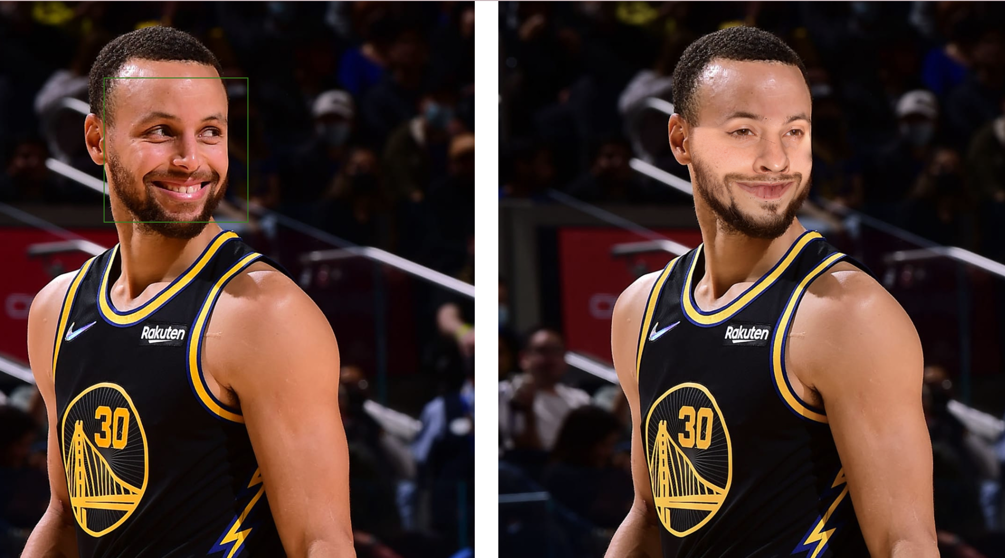
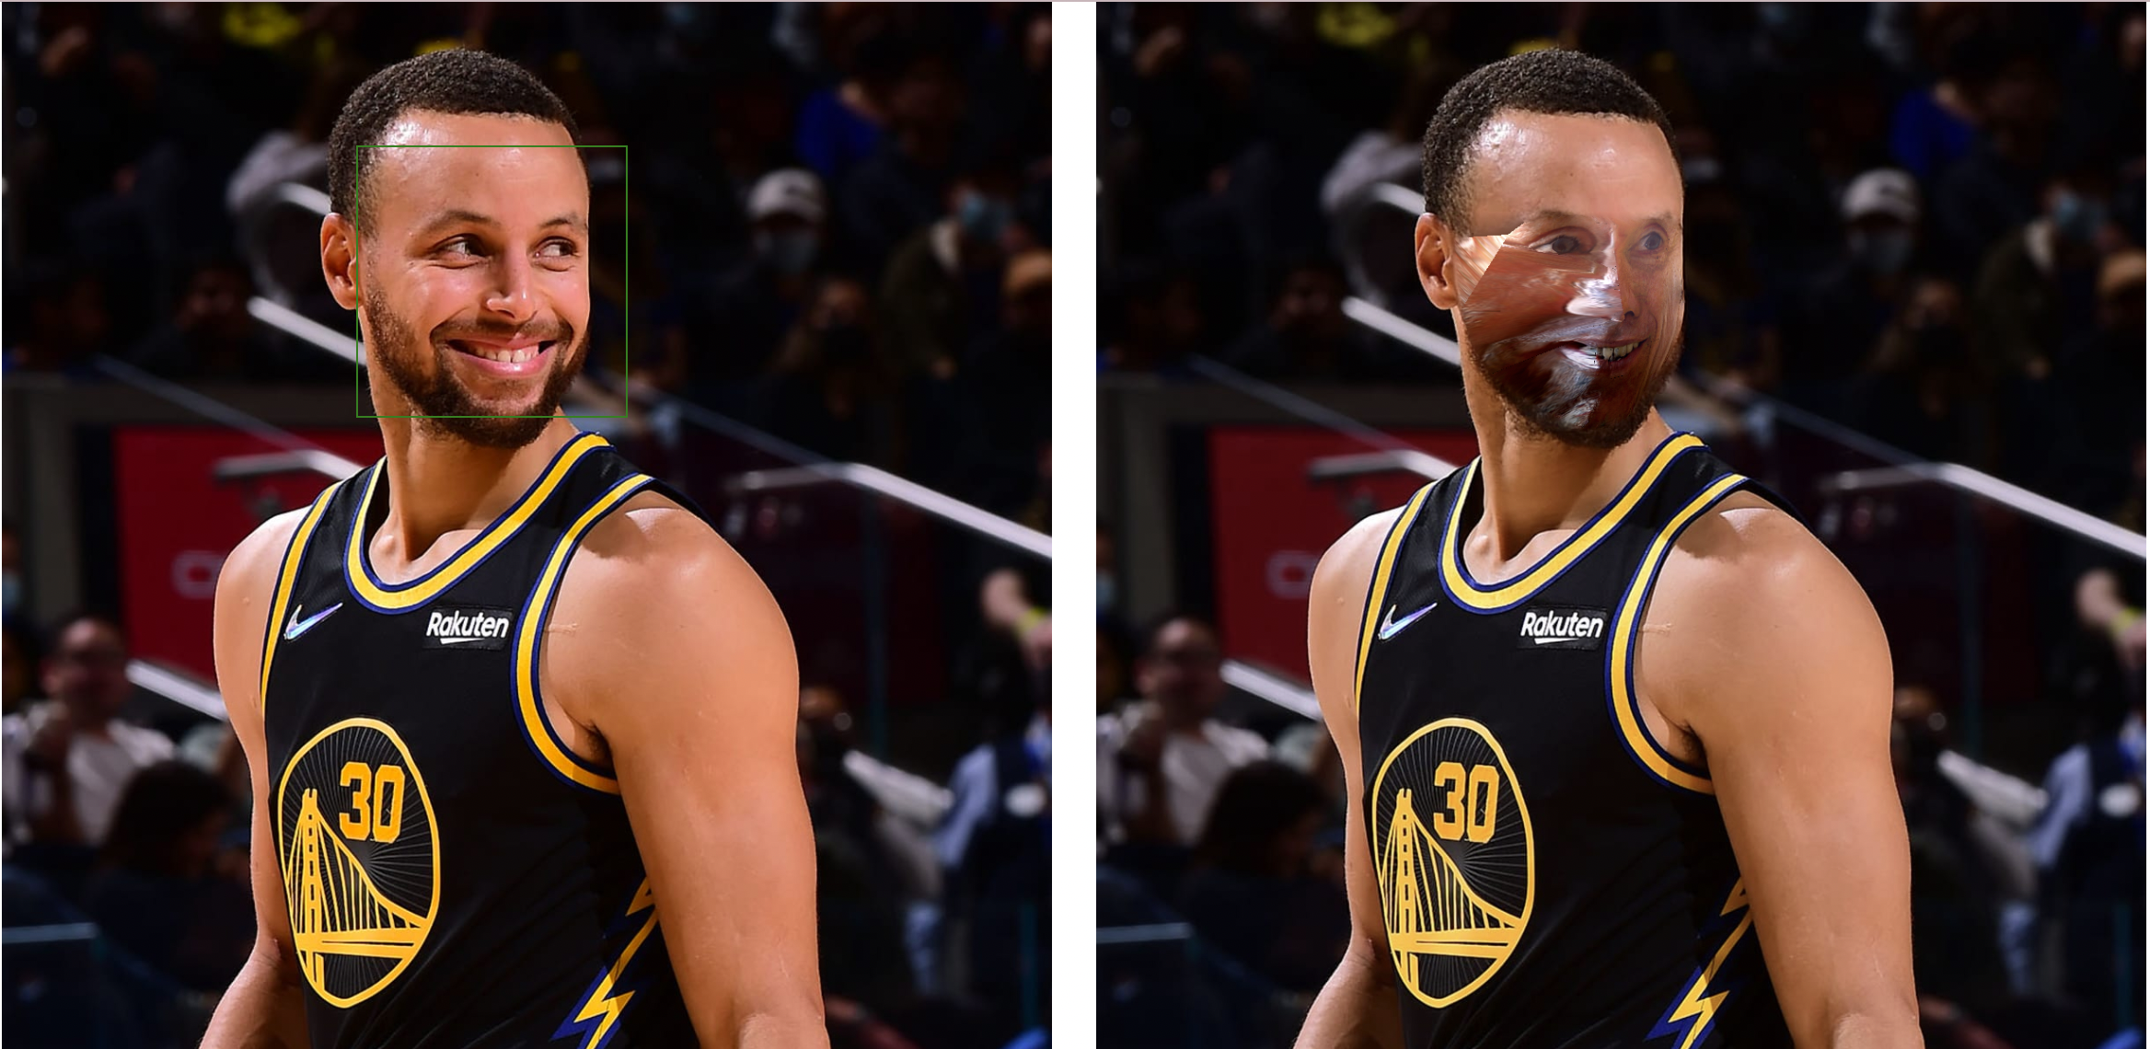
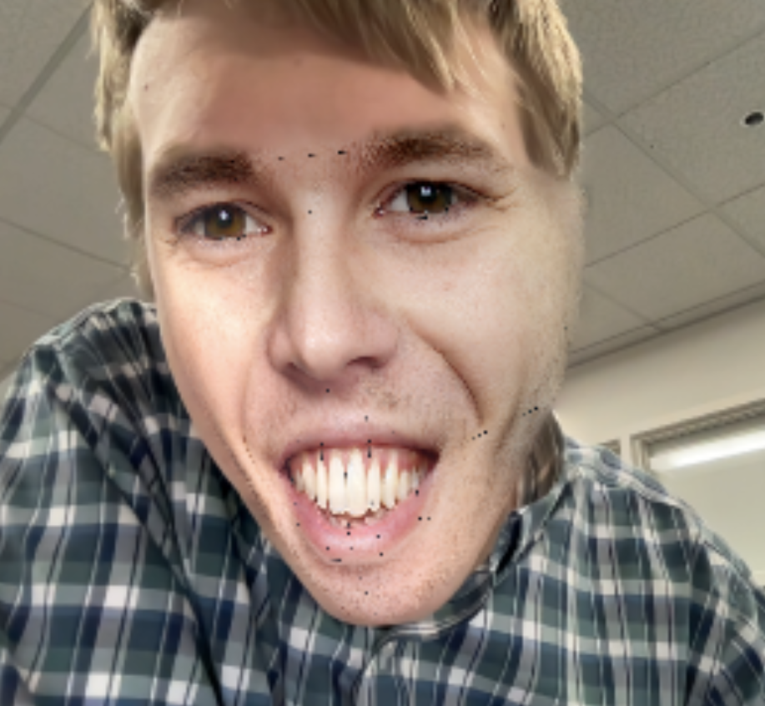
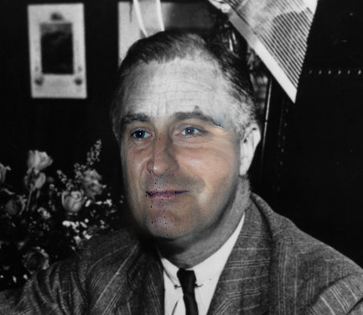
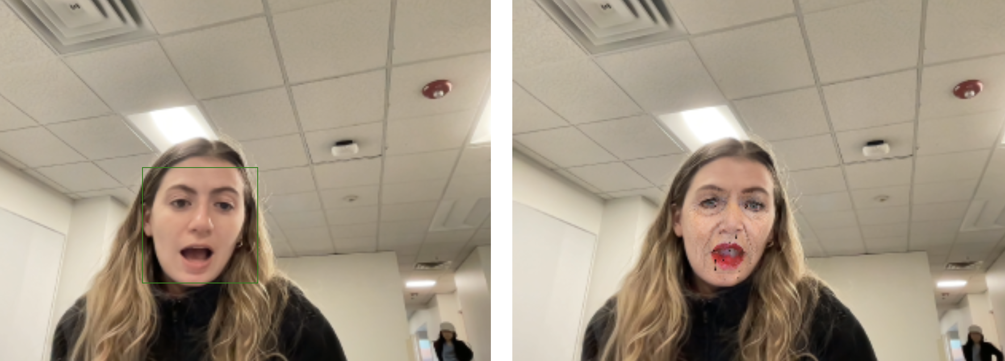
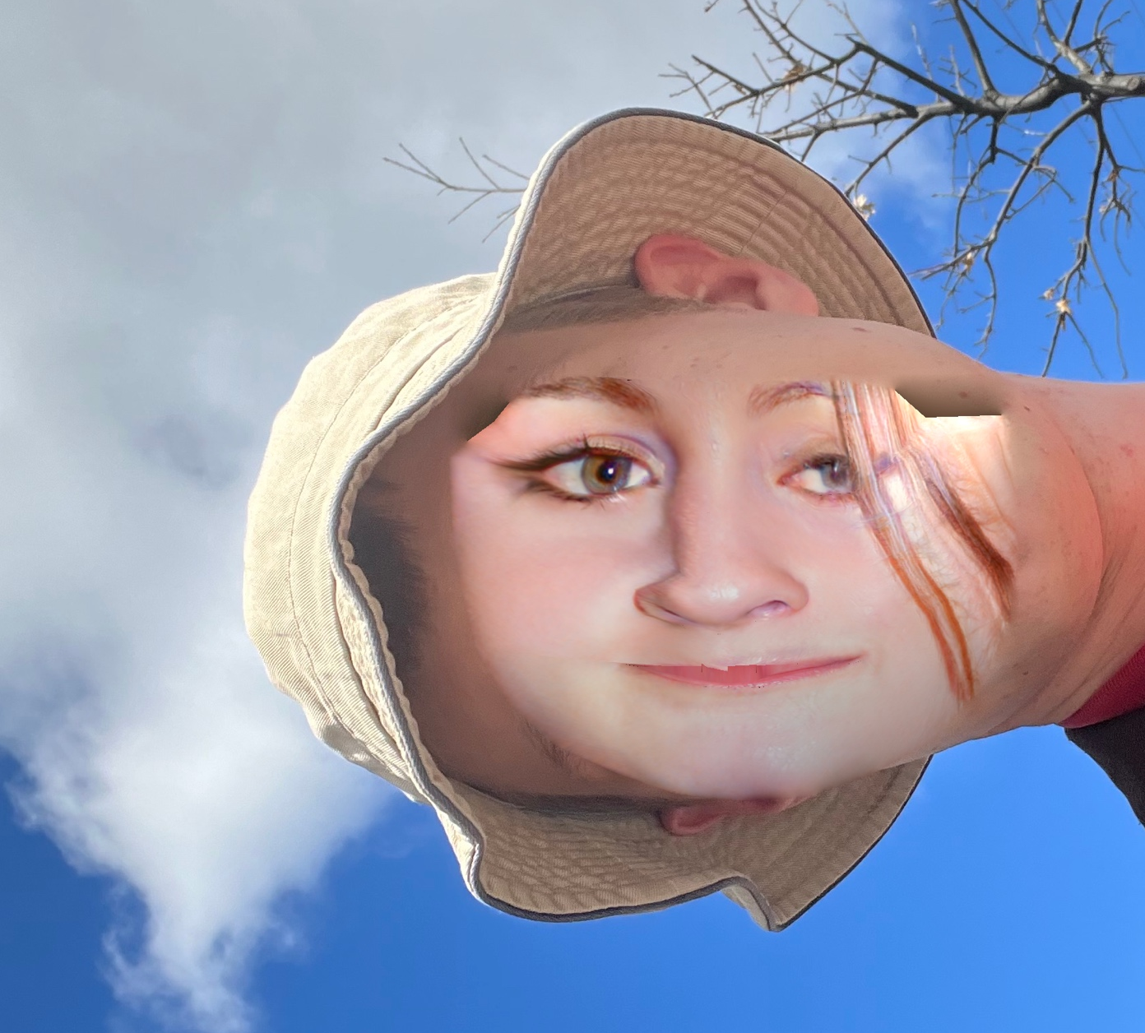
Face Anonymizer
Andrés Beck-Ruiz, Claire Oberg, Jed Fox
Motivation
Define the problem
Goal
We wanted to build a system that allows users to easily anonymize faces in an image or video for privacy reasons, while still maintaining important signals like facial expressions.
Existing approaches use complex models that may be difficult to run on consumer hardware
We want to retain facial expressions and other information useful for humanizing people without identifying them
We don’t want to draw from images of real people as the replacements
Anonymize people in an image by replacing the original face with an AI-generated face based on:
Gender estimation
Whether or not face is smiling with teeth
Neural Network Architecture and Loss/Accuracy Graphs
The Flash of Insight
Our gender prediction model achieved an accuracy of 94.5% on the training dataset.
After following a tutorial for swapping faces, we noticed that choosing a face of a different predicted gender led to suboptimal results. For example, swapping a female face for a male face resulted in visible seams or a distorted resulting image. Similarly, we found that swapping a face containing visible teeth with a face where teeth are not visible produced similar results. Therefore, we implemented a CNN model to predict gender and an algorithm for detecting whether teeth or visible or not. Based on these classifications, we were able to choose the best face to anonymize an uploaded image with.
Results
References
Acknowledgements
[1] Sergio CanuHi.Face swapping (explained in 8steps) - opencv with python, Jun 2019.Available athttps://pysource.com/2019/05/28/face-swapping-explained-in-8-steps-opencv-with-python/.
[2] GuoQuanhao.shapepredictor68facelandmarks.dat,Nov2019.Availableathttps://github.com/GuoQuanhao/68points/blob/5062450a98a958501ff307703f5721f8fb11692d/shapepredictor68facelandmarks.dat
[3] Tero Karras, Samuli Laine, Miika Aittala, Janne Hellsten,Jaakko Lehtinen, and Timo Aila. Analyzing and improving theimage quality of StyleGAN. InProc. CVPR, 2020.
[4] Sefik Serengil.Age and gender prediction withdeep learning in opencv, May 2021.Available athttps://sefiks.com/2020/09/07/age-and-gender-prediction-with-deep-learning-in-opencv/.
We would like to thank all the staff in the course with a special thank you to our
professor and final project TA, Henry. We would also thank all of the celebrities
who unwittingly participated in our project.

